Slide 1
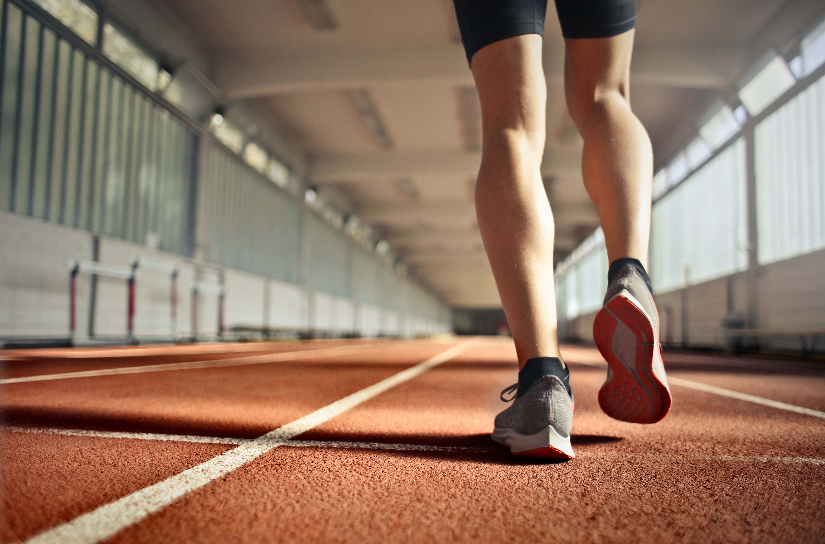
Predicting Injury in Runners
Caitlin Rookey
Pierina Logrono
IST 707
Final Project

Slide 2
Introduction
The most common types of running injuries are related to overuse (NIH).
Estimated that about 70% of runners sustain overuse injury a year
Other factors: shoes, biomechanics, terrain
Our dataset includes 7 years of information about a high-level running team in the Netherlands.
Applied machine learning techniques can help optimize training for each runner based on their training and injury history.

Slide 3
Motivation
Both interested in fitness
Both use some sort of fitness tracker
Current (injured) runner!

Slide 4
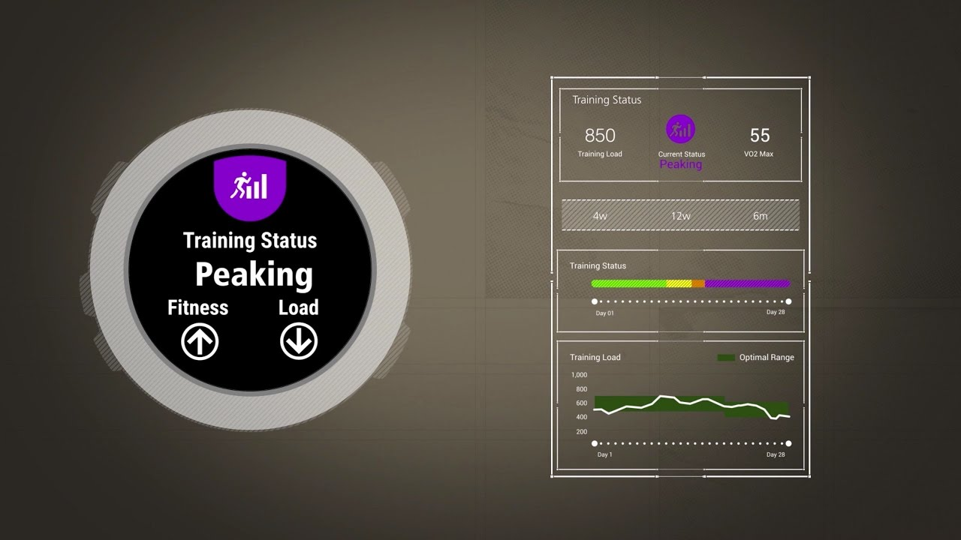
Problem Statement
Determine if a specific variable has an impact on overuse injuries

Slide 5
About the Data
nr. sessions | # of sessions
total km | Total kilometer (GPS watch)
km Z3-4 | Kilometers in zone 3-4 (GPS watch)
km Z5-T1-T2 | Kilometers in zone 5 (GPS watch)
Total.km | Total kilometers (GPS watch)
Km.z3.4 | Kilometers in zone 3-4 (GPS watch)
km.Z5.T1.T2 | Kilometers in zone 3-5 (GPS watch)
km sprinting | Kilometers sprinting (GPS watch)
strength training | Strength training session (binary)
hours alternative | Hours of cross training
perceived exertion | Perceived exertion entered in training log (Subjective)
perceived trainingSuccess | Perceived training success entered in training log (Subjective)
perceived recovery | Perceived recovery entered in training log (Subjective)
Athlete ID | Athlete’s unique identifier (0-71)
Injury | Binary
Date | Numerical (1-267)
Daily (7 days leading up to injury)

Slide 6
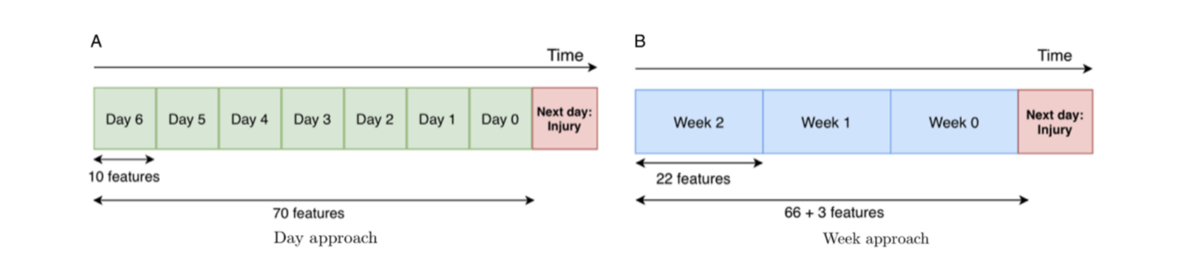
About the Data
Decided to focus on daily dataset only
Daily data was more successful in the model developed by the researchers that did the initial study
Narrowing the scope allowed us to spend more time on the models

Slide 7
EDA and Visualizations
No missing values/NA's
Challenging to obtain Stats and Visualize due to the structure
Data wrangling is still in progress

Slide 8
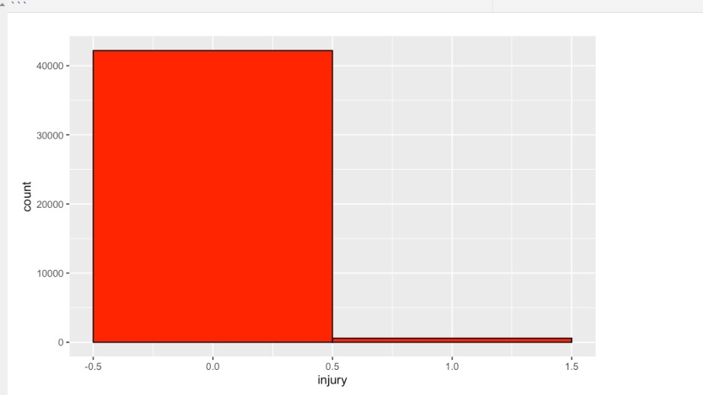
583 Injuries

Slide 9
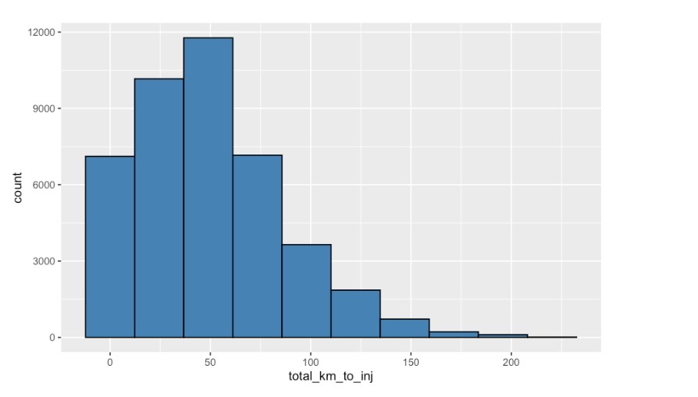
Km ran 7 days before injury

Slide 10

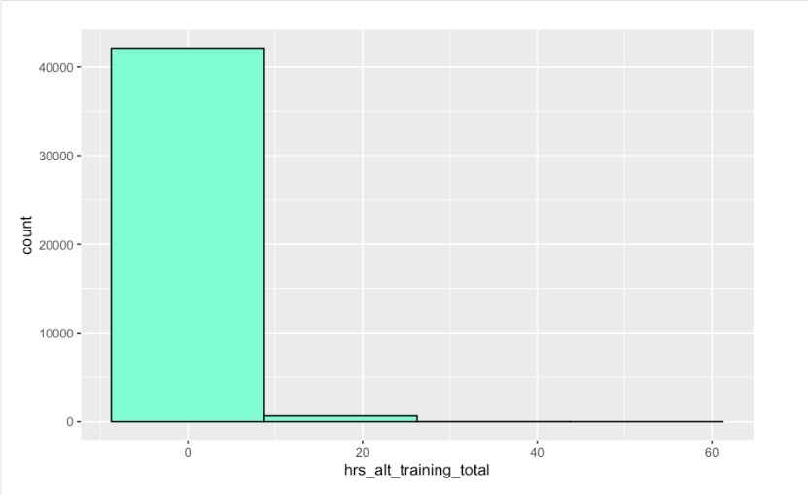
Hours of alternative training leading to injury

Slide 11
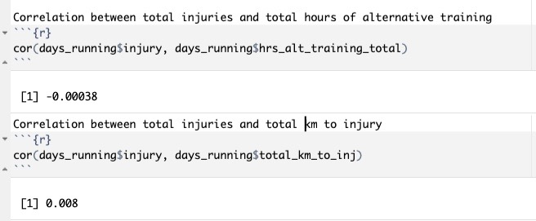
Correlations

Slide 12
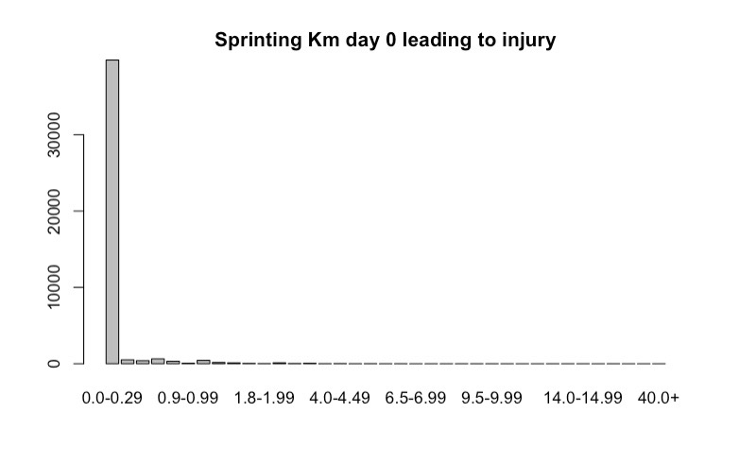
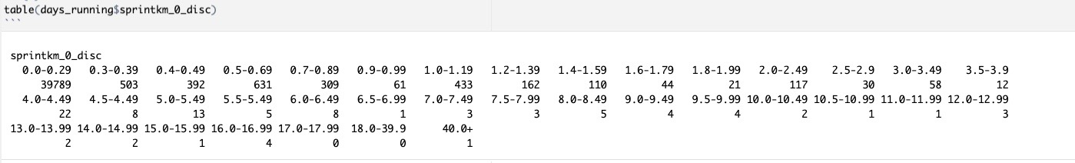
Sprinting Km day 0 leading to injury

Slide 13
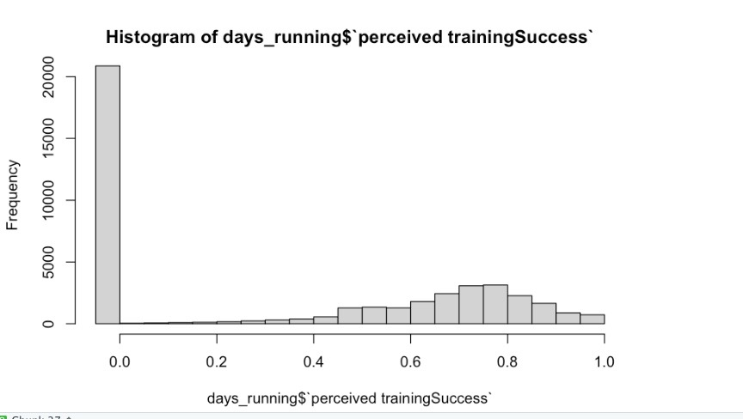
Perceived Training Success

Slide 14
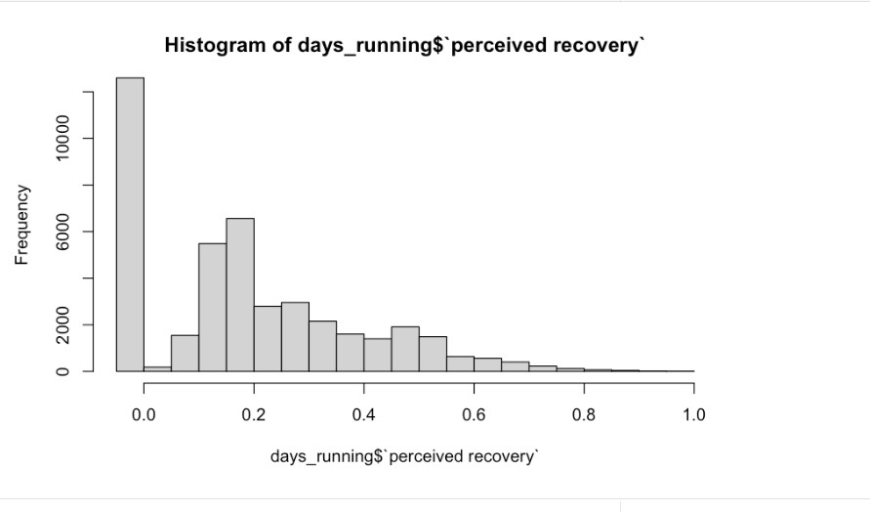
Perceived Recovery

Slide 15
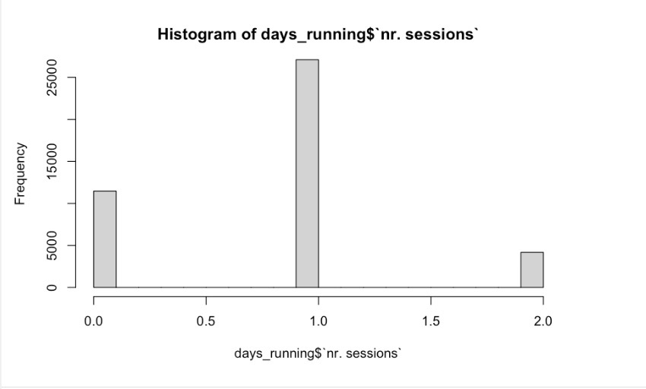
Number of sessions per day

Slide 16
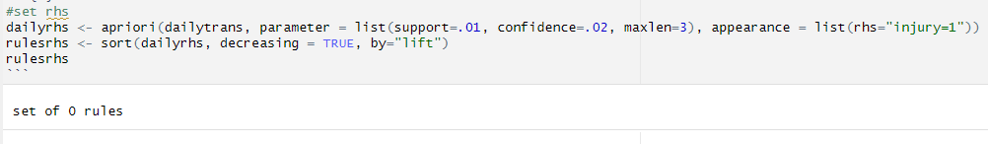
Association Rule Mining
We made many attempts at ARM while setting the RHS to "injury" so see if any variables in the days leading to injury had an impact but found no rules.

Slide 17
Preparing for Predictive Models
Struggle with normalization
Unbalanced data set
We did a good amount of sampling until we found the "right" number, to balance the data set

Slide 18
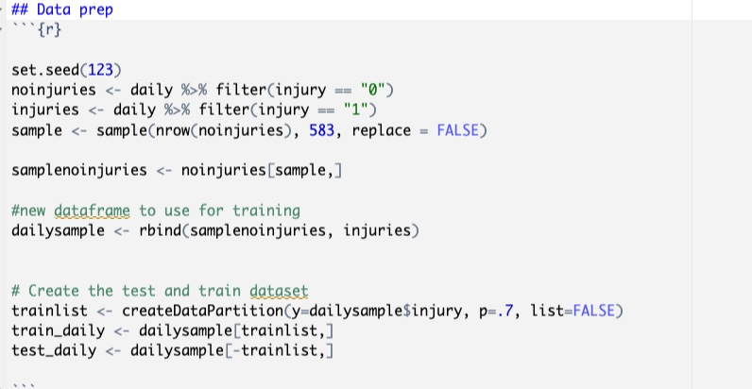
Sampling from Data set

Slide 19
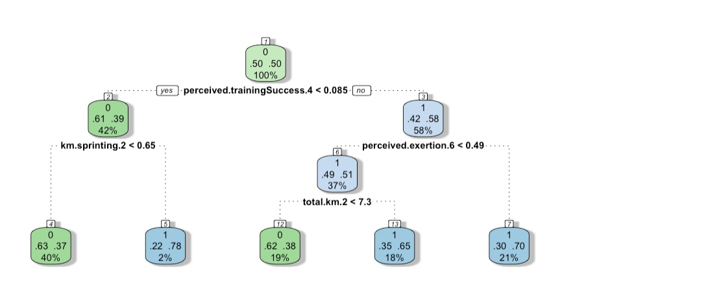
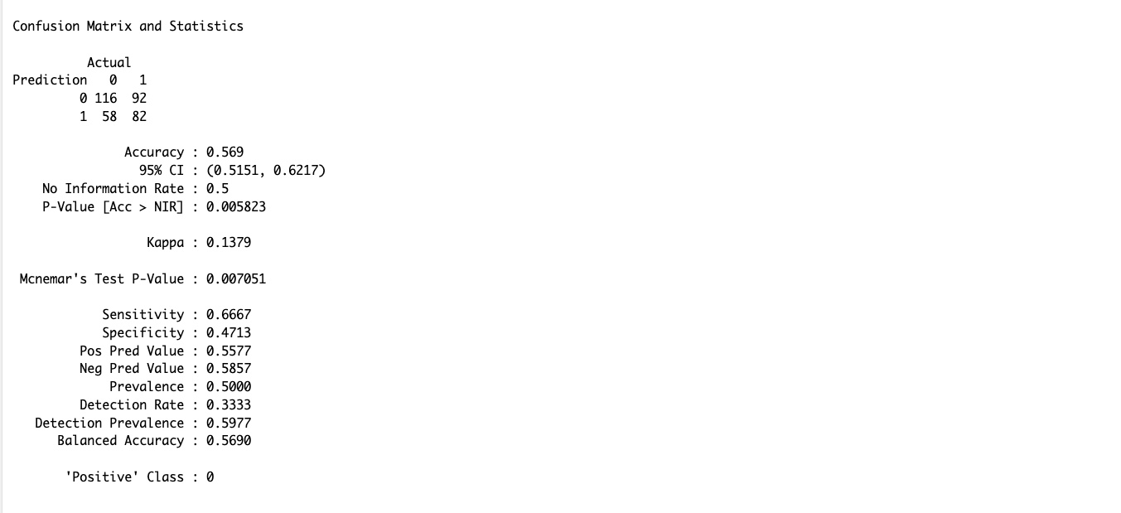
Decision Trees

Slide 20
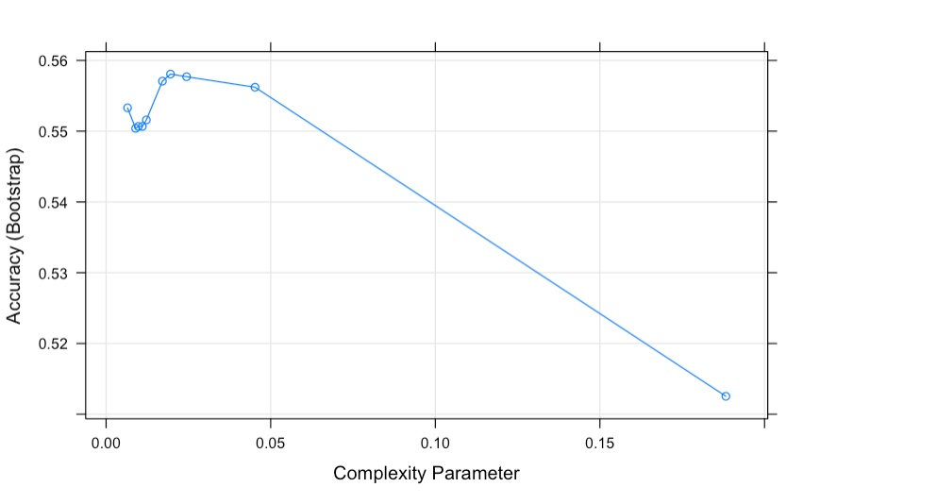
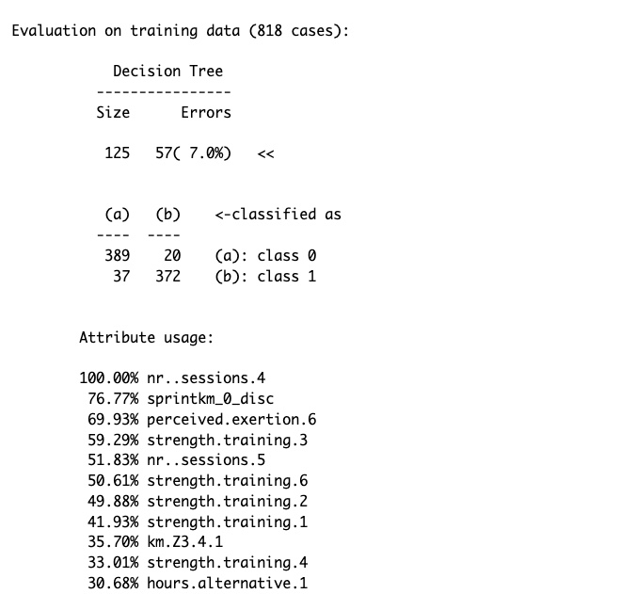
Decision Trees (cont'd)
DT2_boosted <-C5.0(dailytrainKMsubset %>% select(-injury), dailytrainKMsubset$injury, trials = 5)

Slide 21
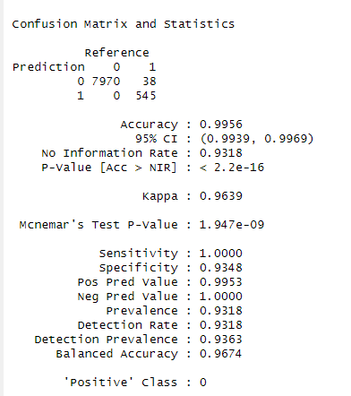
Random Forest
Tried using full dataset and subsets
Accuracy: 99.56%

Slide 22
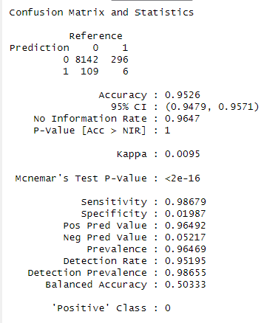
Naïve Bayes
Subset of kilometers – all sessions (objects) included
Accuracy: 95.26%
But too many false positives

Slide 23
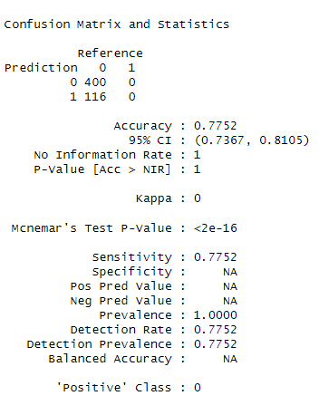
SVM
Started with a sample of 818. Accuracy hovered around 60%.
Took a sample size of 2000 due to time and computing constraints
Using linear kernel
Accuracy = 77.52%

Slide 24
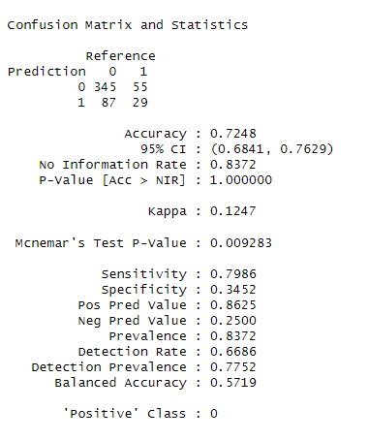
SVM
Took a sample size of 2000 due to time and computing constraints
Using polynomial kernel
Accuracy = 72.48%

Slide 25
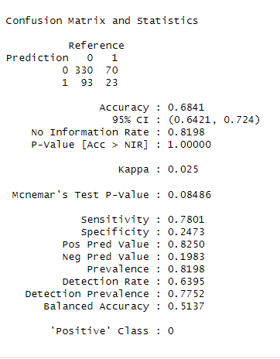
SVM
Took a sample size of 2000 due to time and computing constraints
Using sigmoid kernel
Accuracy = 68.4%

Slide 26
Conclusion
Most of the models predicted injury well
Other models can tackle this type of problem and data set with more success
Neural network would have been interesting
Great learning experience

Slide 27
References
Title photograph: Credit: Photo by Andrea Piacquadi
https://www.kaggle.com/datasets/shashwatwork/injury-prediction-for-competitive-runners
https://pure.rug.nl/ws/portalfiles/portal/183763727/_15550273_International_Journal_of_Sports_Physiology_and_Performance_Injury_Prediction_in_Competitive_Runners_With_Machine_Learning.pdf
https://www.ncbi.nlm.nih.gov/pmc/articles/PMC3445255/

